Slide 1
An Analysis of Semantic & Syntactic Equivalence of Questions using Word2Vec model and classification algorithms
Muhammad Arshad

Slide 2
Problem Definition:
Problem: A major problem for Q/A websites like Quora or Stack Overflow for database management is duplicate questions.
Task: Grouping questions automatically, leading to same answers on same page for efficient literature review and better readability.

Slide 3
Proposed Solution
Train a classification model using a large dataset of questions with two labels (0 , 1) where 0 means questions are not similar and 1 means they are similar.
Predict the similarity index the newly post questions using the trained classifier.

Slide 4
Project Breakdown:
1. Get the questions data (open-sourced)
2. Preprocess the data (lower-case, stop words etc.)
3. Tokenize the data
6. Find the mean feature vector for questions
5. Extract feature vectors for each word in dataset
4. Train the word2vec model
7. Shuffle and Divide the features and labels vectors
8. Train a classifier (SVM & kNN)
9. Accuracy Test, Label Predictions

Slide 5
Word2Vec Model
Proposed by Thomas Mikolov in his paper titled as,‘Distributed Representations of Words and Phrases and their Compositionality’
Word2Vec model captures semantic equivalence of each word in corpus depending on the company it (the word) keeps.
An interesting outcome of word of word2vec model is that we can add and subtract word vectors to make sense. For example;
Vec(‘King’) + Vec(‘Woman’) – Vec(‘Man’) = Vec(‘Queen’)
Vec(‘Madrid’) - Vec(Spain) + Vec(‘France’) = Vec(‘Paris’)
(Results depend on word2vec training’s corpus, the above two examples are from the original papers)

Slide 6
K-Nearest Neighbors
Body Mass
Body Mass
Body Mass
Age
Age
Age
Body Mass
Body Mass
Body Mass
Where do I belong?
Age
Age
Age

Slide 7
Support Vector Machine:
Body Mass
Body Mass
Body Mass
Hyperplane
Age
Age
Age
Body Mass
Body Mass
Body Mass
Where do I belong?
Age
Age

Slide 8
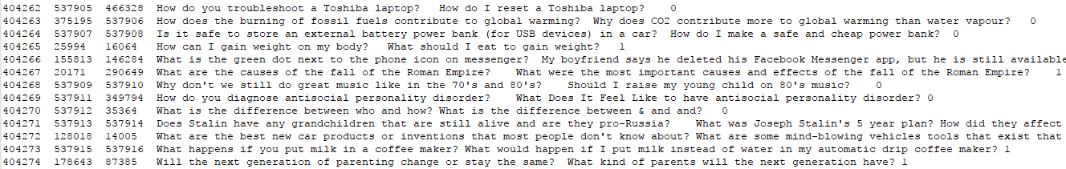
1. Get the questions data (open-sourced)
Quora open-sourced the questions-pair dataset as a challenge for natural language processing’s researcher in 2015.
Link for dataset: https://data.quora.com/First-Quora-Dataset-Release-Question-Pairs
404290 Questions pair (404290 x 2 questions in total).
Following is the sample of the raw data.

Slide 9
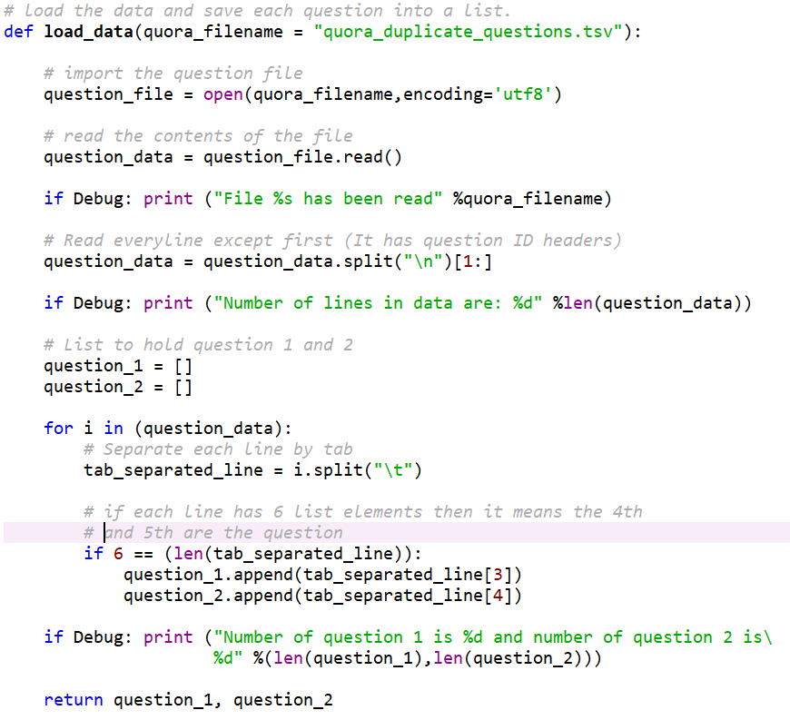
2. Preprocess the data (lower-case, stop words etc.)

Slide 10
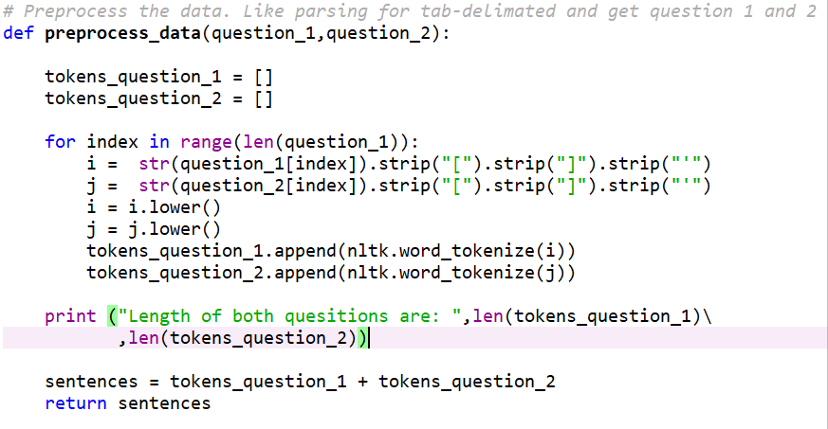
3. Tokenize the data

Slide 11
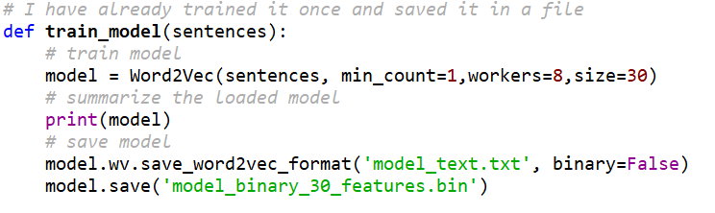
4. Train the word2vec model

Slide 12
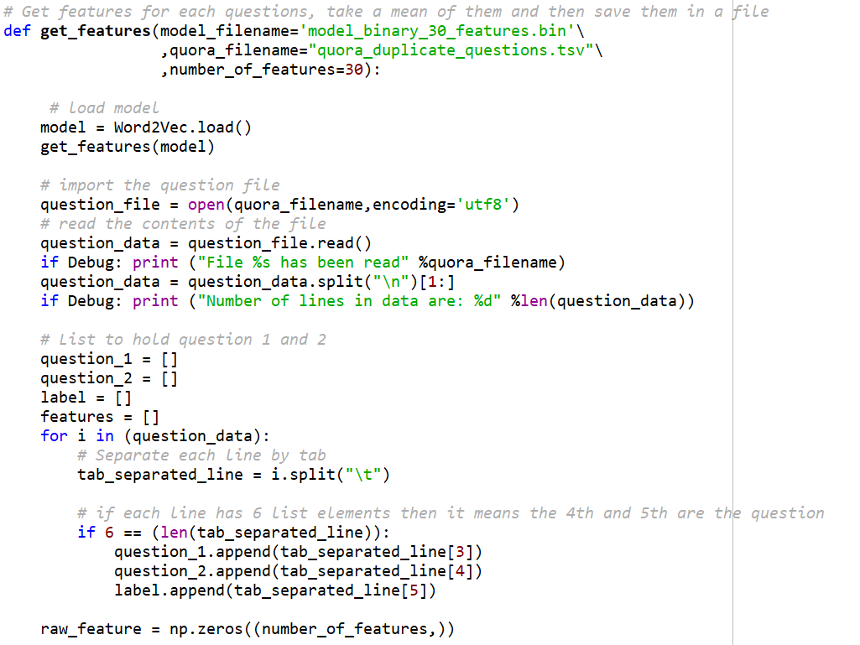
5. Extract feature vectors for each word in dataset

Slide 13
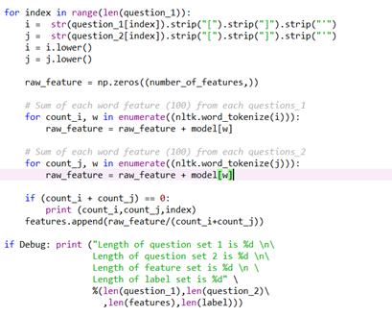
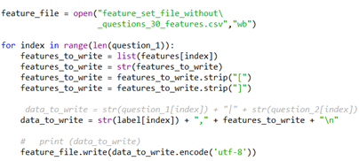
6. Find the mean feature vector for questions

Slide 14
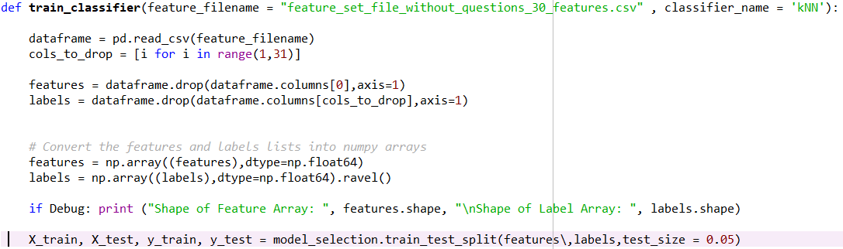
7. Shuffle and Divide the Features (vectors) and Labels (Randomization)

Slide 15
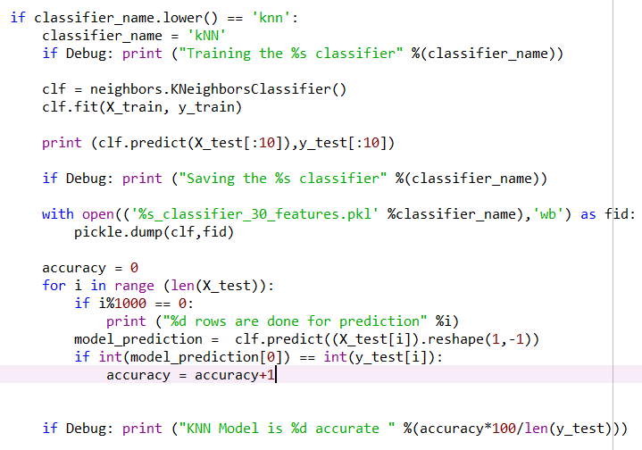
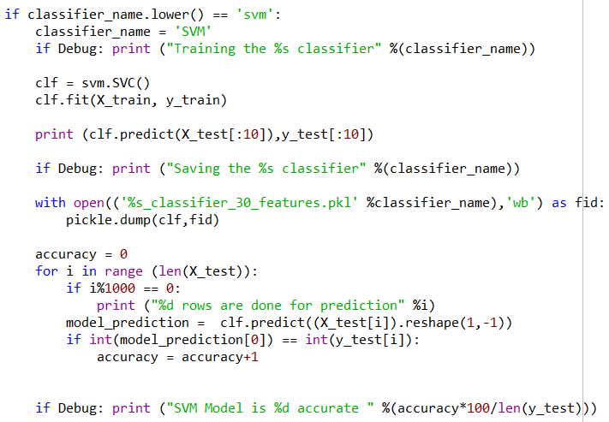
8. Train a classifier (SVM or kNN)

Slide 16
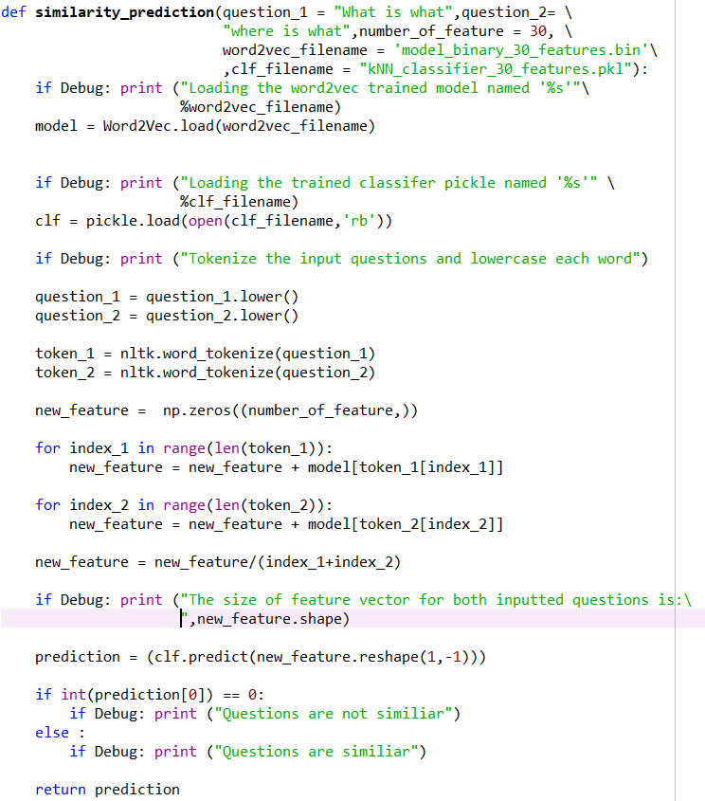
9. Accuracy Test & Label Prediction

Slide 17
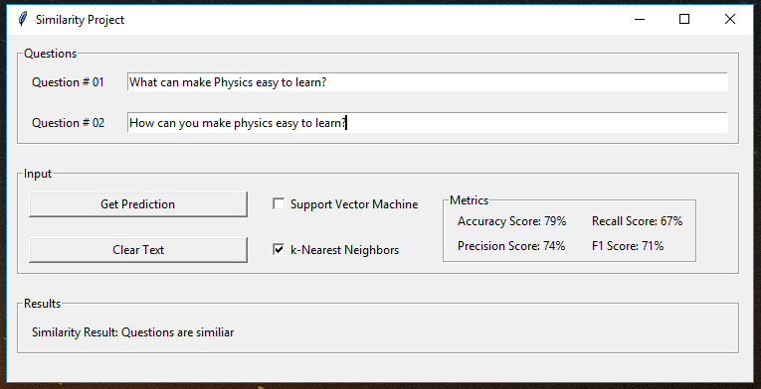
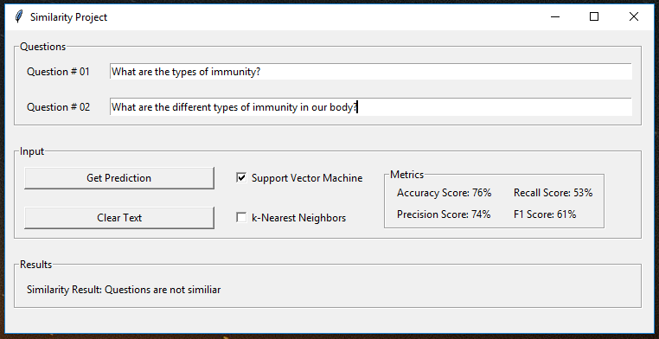
Graphical User Interface

Slide 18
Metrics to Validate Classifiers
 | Semantic Equivalent | Semantic Inequivalent
Classifier predicts semantic equivalent | True Positive (TP) | False Positive (FP)
Classifier predicts semantic inequivalent | True Negative (TN) | False Negative (FN)

Slide 19
Results
Metrics | K-Nearest Neighbors | Support Vector Machine
Accuracy Score | 79% | 76%
Precision Score | 74% | 74%
Recall Score | 67% | 53%
F Score | 71% | 61%
Accuracy Score = (TP + TN) / Total Predictions
Precision Score = TP / (TP + FP)
Recall Score = TP / (TP + FN)
F Score = 2 * (Precision Score * Recall Score) / (Precision Score + Recall Score)
TP = True Positive
TN = True Negative
FP = False Positive
FN = False Negative

Slide 20
Thank you
Question and Answer

